Slide 1
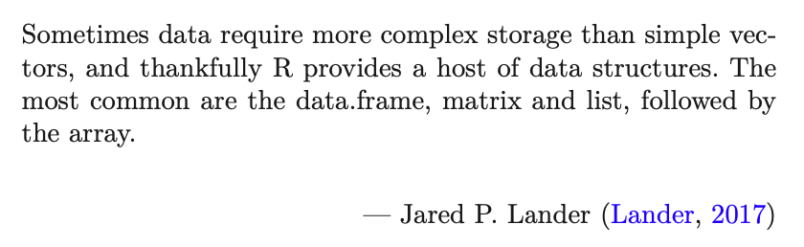
Exploring Operations Research with R: A Workshop
02 - Tibbles
https://github.com/JimDuggan/Exploring-OR-with-R-Workshop

Slide 2
Topics Overview
Topic | Description | ~Timing
1 | Introduction to R and Posit Cloud | 10 mins
2 | Storing data using data frames / tibbles | 10 mins
3 | Visualisation with ggplot2 | 20 mins
4 | Data transformation with dplyr | 20 mins
5 | OR Example 1 – Exploratory Data Analysis | 15 mins
6 | OR Example 2 – System Dynamics | 15 mins

Slide 3
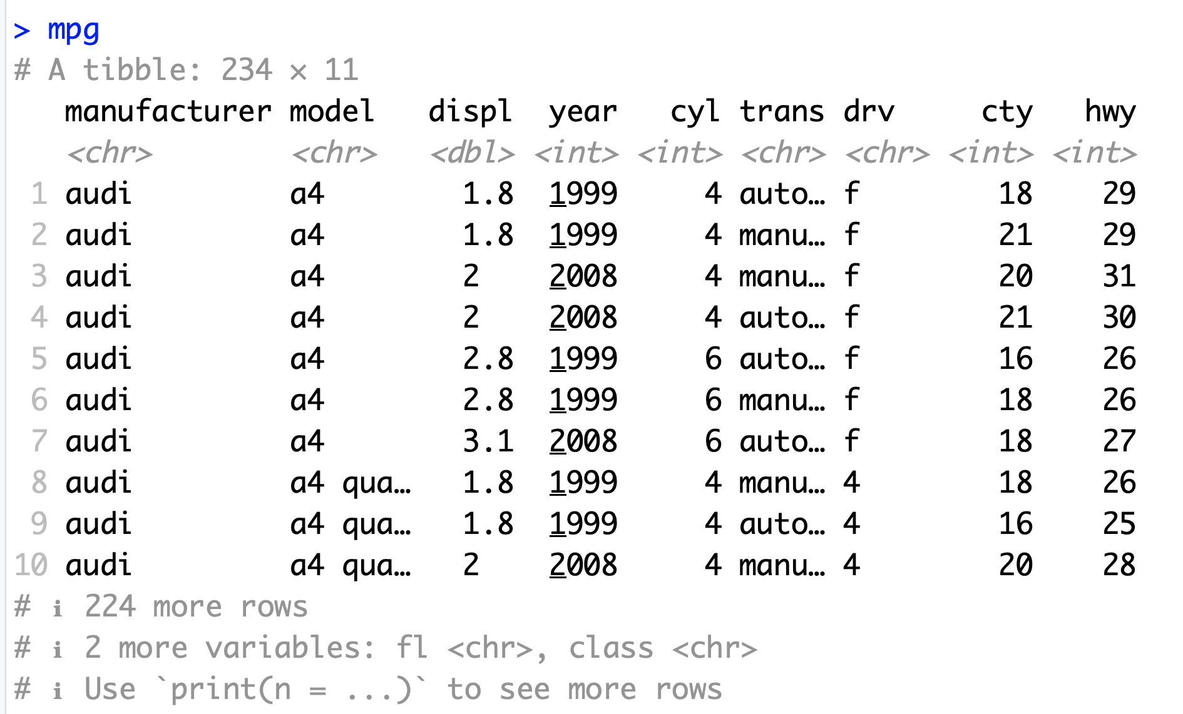
Data Frames/Tibbles
The most common way of storing data in R
A two-dimensional structure, with rows (observations) and columns (variables)

Slide 4
tibble abbreviations (variable types)
Abbreviation | Data Type
int | integers
dbl | doubles (real numbers)
chr | character vectors (strings
dttm | date-times
lgl | logical
fctr | factor (categorical variables with fixed possible values)
date | dates

Slide 5
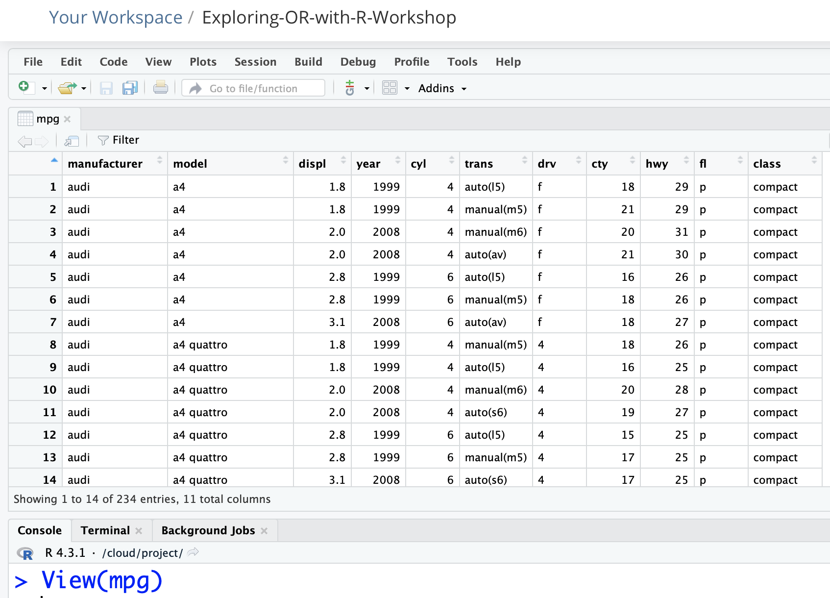
In the computer’s memory, just like a spreadsheet

Slide 6
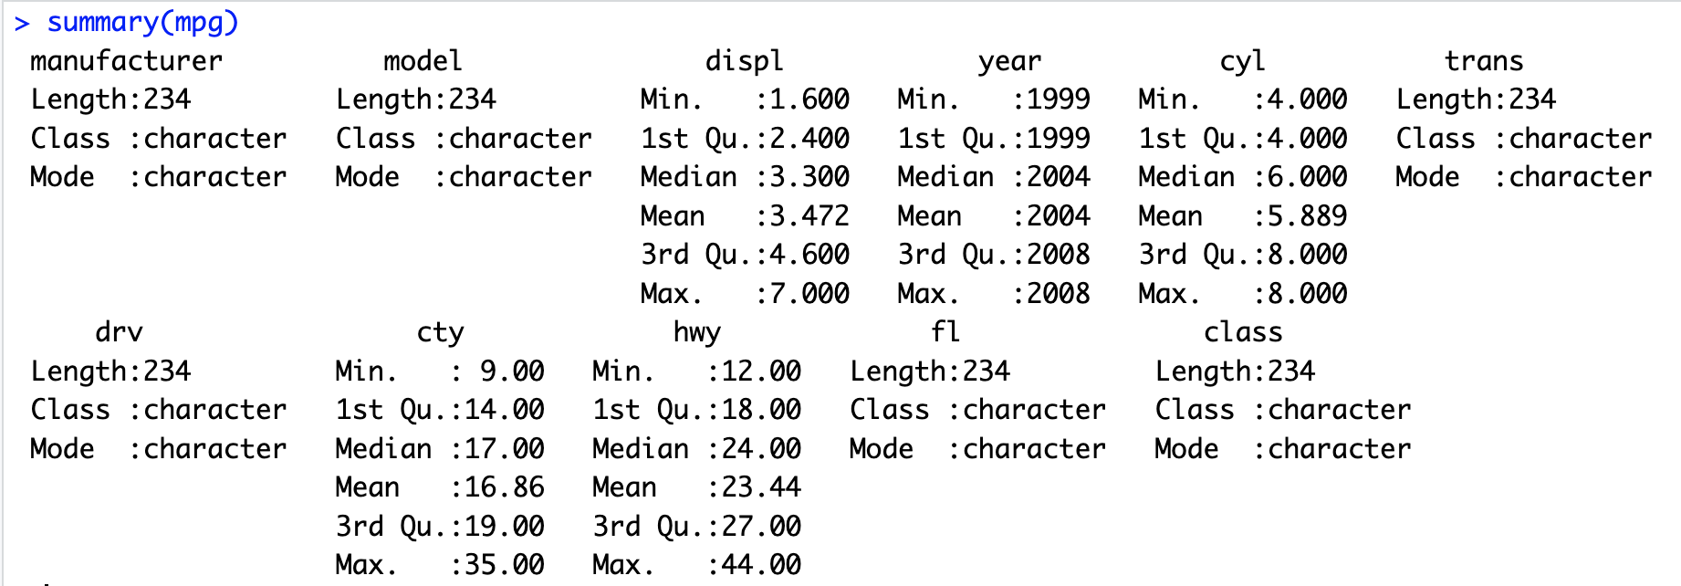
The summary() function

Slide 7
Challenge 3.1
Explore some of the following tibbles in R
mpg (ggplot2)
diamonds (ggplot2)
observations (aimsir17)
eirgrid17 (aimsir17)
stations (aimsir17)

